Slide 1
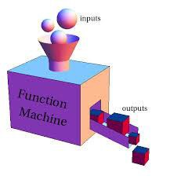

COA123 Web Programming
Week 4:
JavaScript revision

Slide 2
Overview
Introduction to HTML
Tags, attributes, class/ID selector, CSS etc.
Introduction to JS
Input/output: prompt(…), alert(…);
Variable var & data types
– Variables：arithmetic operators: +
- * / % (modulo)
Conversion (strings -> numbers): Number(…); parseInt(...)
Math object: Math.sqrt(...), round(...), ceil(...), floor(...),
max(...,...), min(...,...), PI

Slide 3

Summary
Iteration, arrays, conditionals
Loop:
for
do … while
while …
Array
•
Logical operators &&, ||, !
Lecture
Truth table
Operator precedence
switch (x){
case x1: stmt0; break;
...
default: defaultStmt;
}
Lab
Practice !

Slide 4
Summary
Programmer-defined Function
Function declaration, call, returns
Formal/actual parameters
Variable scope: global vs local
HTML Forms
DHTML: user interaction with JS

Slide 5
Q&A: Why is it “dash”?
var a=".", w; switch(a){
case ".": w="dot"; break;
case "-":w="dash";
}
alert(w);
Practise test 4

Slide 6
Q&A: practice test 4 (10)
var t=0,sum=1; do{
if(++t%2==1) sum+=t;
}while(t<10);
alert(sum);

Slide 7
Q&A: nested loop
var v=1; for(i=1;i<5;i++)
for(j=2;j<5;j++)
v+=1;
alert(v);
13

Slide 8
Exercises 1.7
Take one number input from the user and find the smallest number which, when squared, is larger than the input number.
(assume that number in the question means a positive integer)
var input=Number(prompt("Enter an Integer:")); alert("answer = "+Math.ceil(Math.sqrt(input +1 )));
Examples: 2, 5, 10 …
Examples: 4, 9, 16

Slide 9
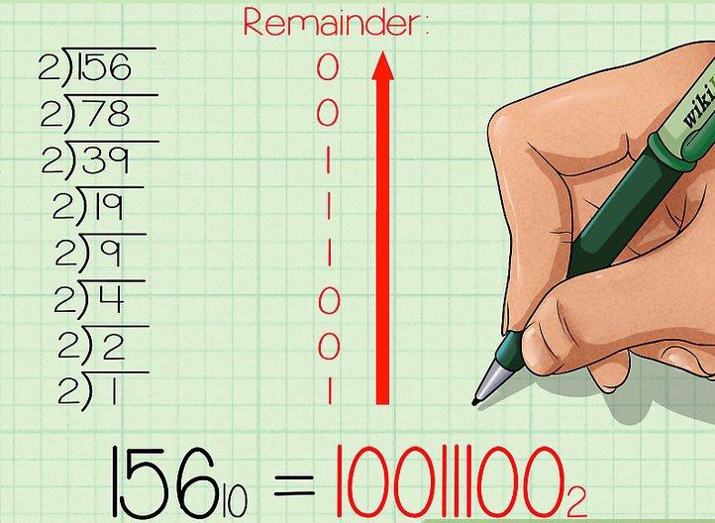
Exe: Convert a Decimal to Binary

Slide 10

DHTML & JavaScript

Slide 11

Revision
Convert a price in USD to GBP
Creating & testing functions

Slide 12
Convert a price in USD to GBP
convert a price in USD to GBP
exchange rate 1 GBP=1.5 USD
Return the converted GBP value, or -1 in case of an error.
function convertToGBP(…){
…
}

Slide 13
Convert a price in USD to GBP
function convertToGBP(dollars) { var pounds = dollars / 1.22;
if( pounds >= 0 ) return pounds;
else
return -1;
}
alert( convertToGBP(100) ); alert( convertToGBP(-28) ); alert( convertToGBP('dollars') );

Slide 14
Asking Questions is a Hard Skill
It is a skill in itself.
University seeks to develop it and other “transferable” skills, including, most importantly, critical thinking.
It is vital to success in life.
It is recognized that it is hard, and something
many of us need to learn…
…but rewarded when done properly.

